Slide 1
Partnership Working Group
People Update - OCC
December 2024

Slide 2
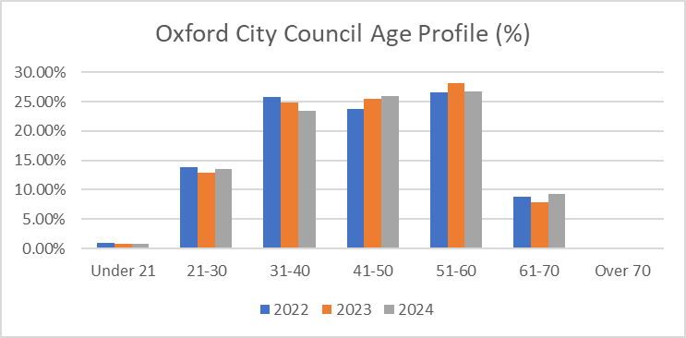
Follow up from last meeting – ageing workforce

Slide 3
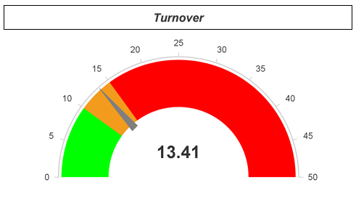
OCC Key metrics –October data (November data not available until 10 or 11 December)
Headcount 842
FTE 771.27
Sickness Absence
Year end projection 8.34 days against 6.5 day target

Slide 4
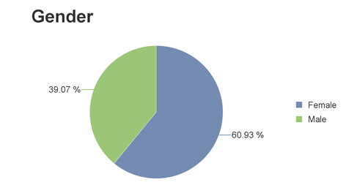
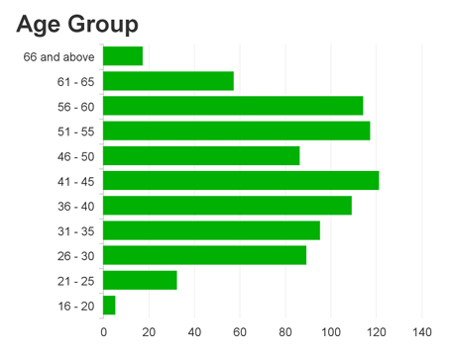
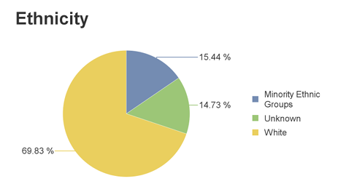
Workforce profile – October data
10.57% of employees class themselves as having a disability

Slide 5
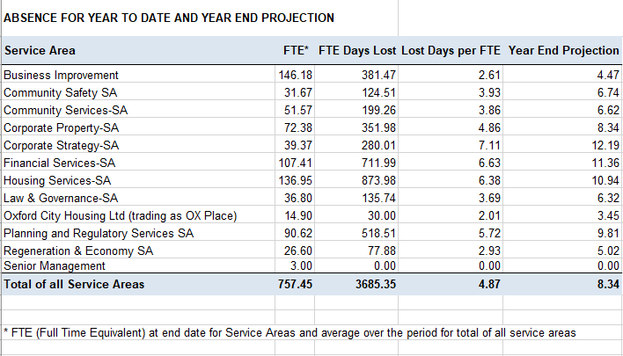
Absence by service area April to October 24

Slide 6
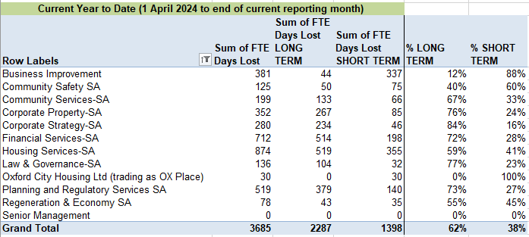
Absence summary with % long and short-term April to October 2024
Note, it is not possible to report on number of people absent on long term absence without a manual intervention as automated reporting is based on FTE

Slide 7
Organisational Development
Aspiring Managers Cohort 2 has commenced
Delivering more training in EDI and Unconscious Bias
44 to start a Multiverse Apprenticeship (AI Powered Productivity, AI for Business Value, Data Insight for Business Decisions, Business Transformation) - Inductions December 2024, Start in January 2025

Slide 8
Organisational Development
Careers Series to Launch in January 2025 – 20 places per quarter
Continuing to improve recruitment processes via work on iTrent
Planning stages for Recruitment Agency Procurement with OCC consultations in early 2025
Work placements and school support

